Slide 1
My Summer Project
Max-Hsu
Second Year of Bachelor In Computer Science
Also Research Assistant of Embedded System Lab

Slide 2
Hackathon
Create something from nothing

Slide 3
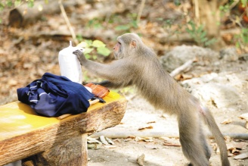
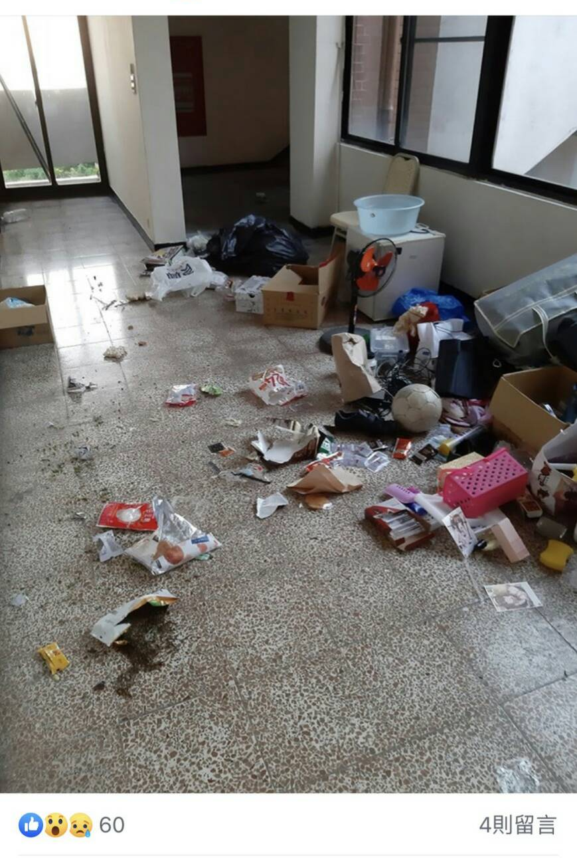
The main Topic of my project

Slide 4
Actually
Monkey not only had invaded into our university
But also ate some crop from farms where is in some mountain areas.
And the farmer’s solution right now is using some fire cracker to scare them away. But it is not affective anymore.

Slide 5
What should we do to prevent the situation?
Feel free to answer

Slide 6
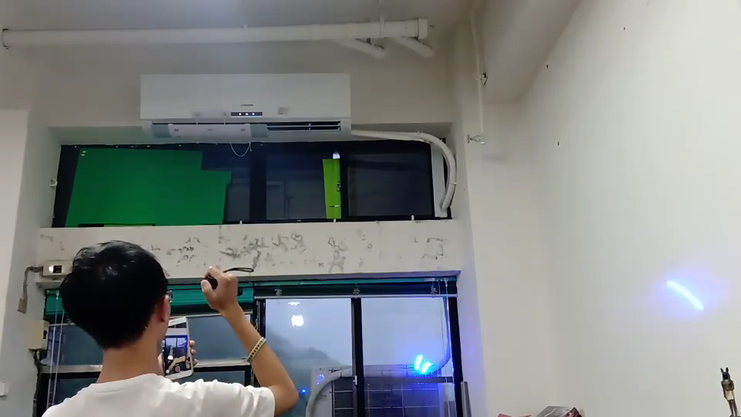
Introduce a new solution

Slide 7
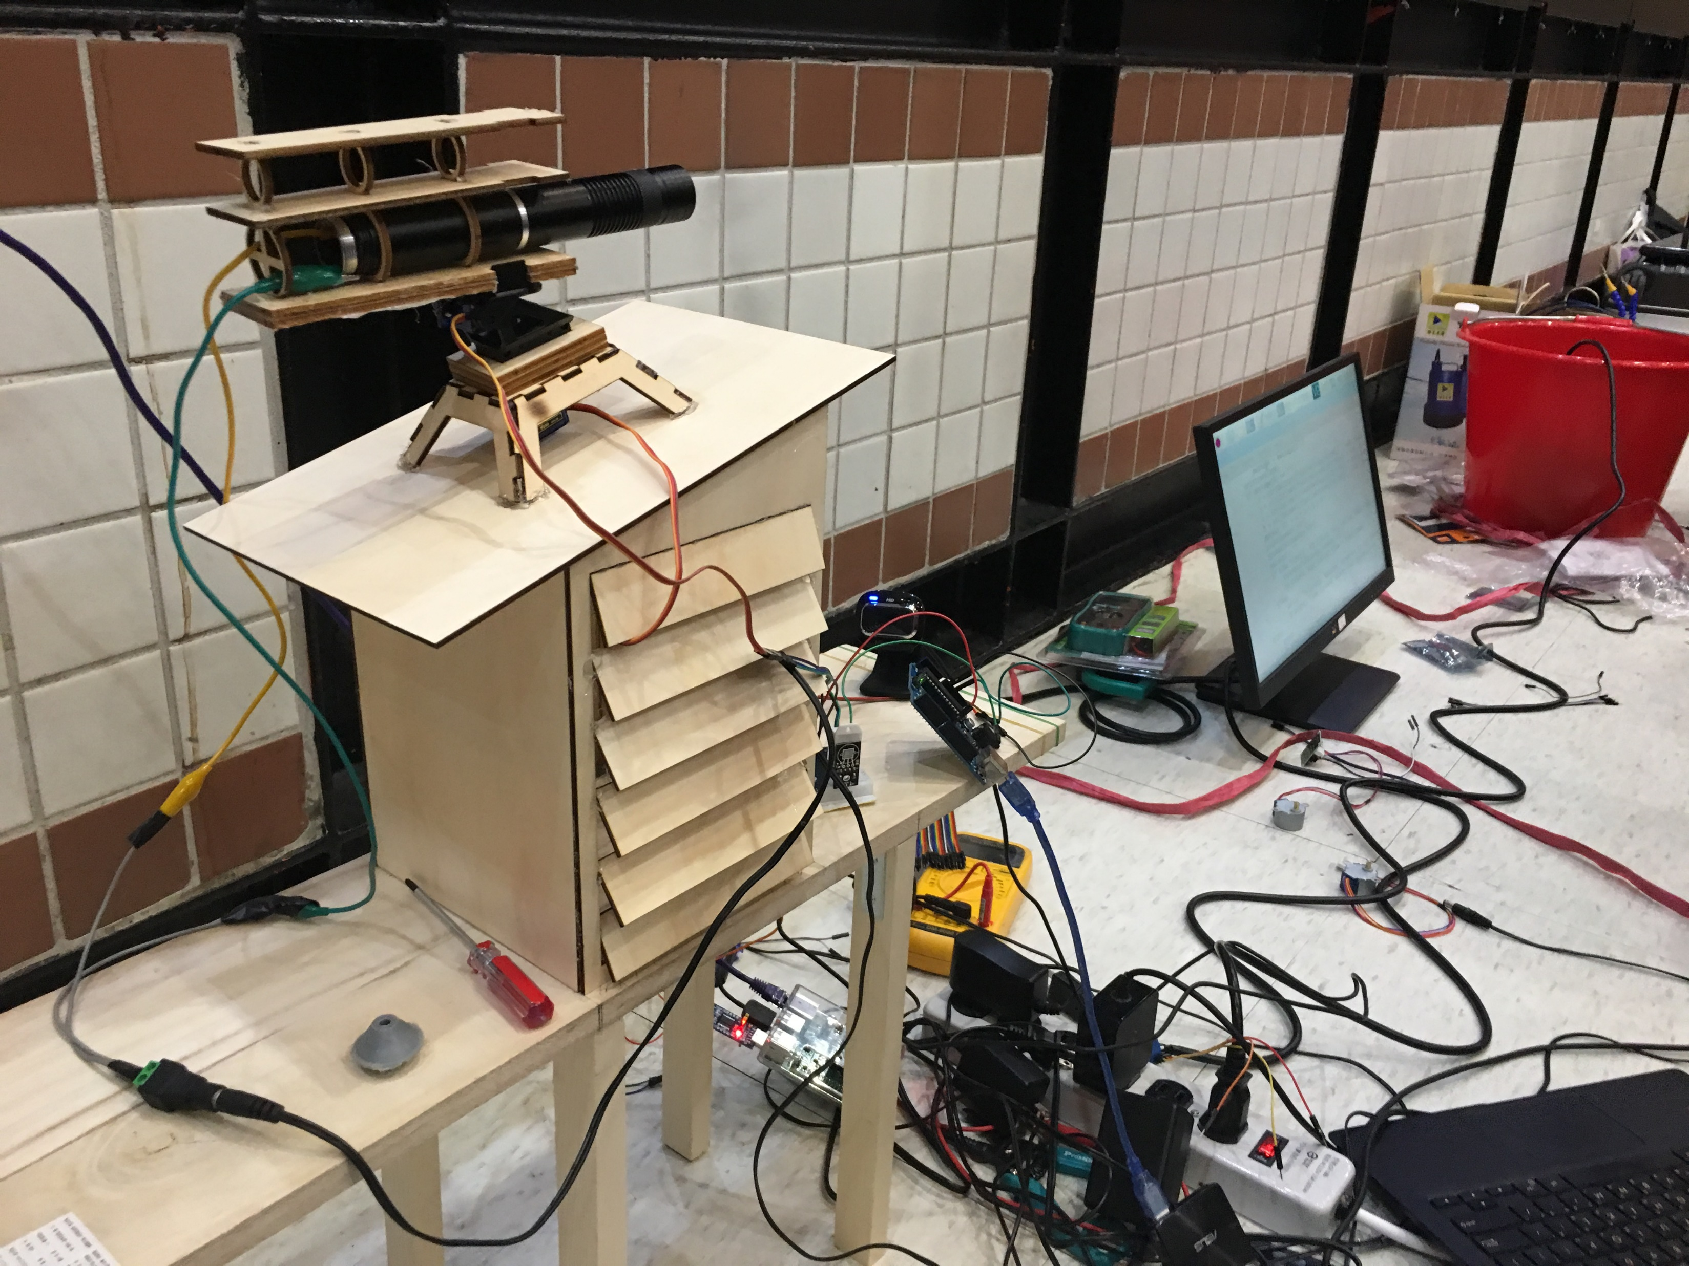
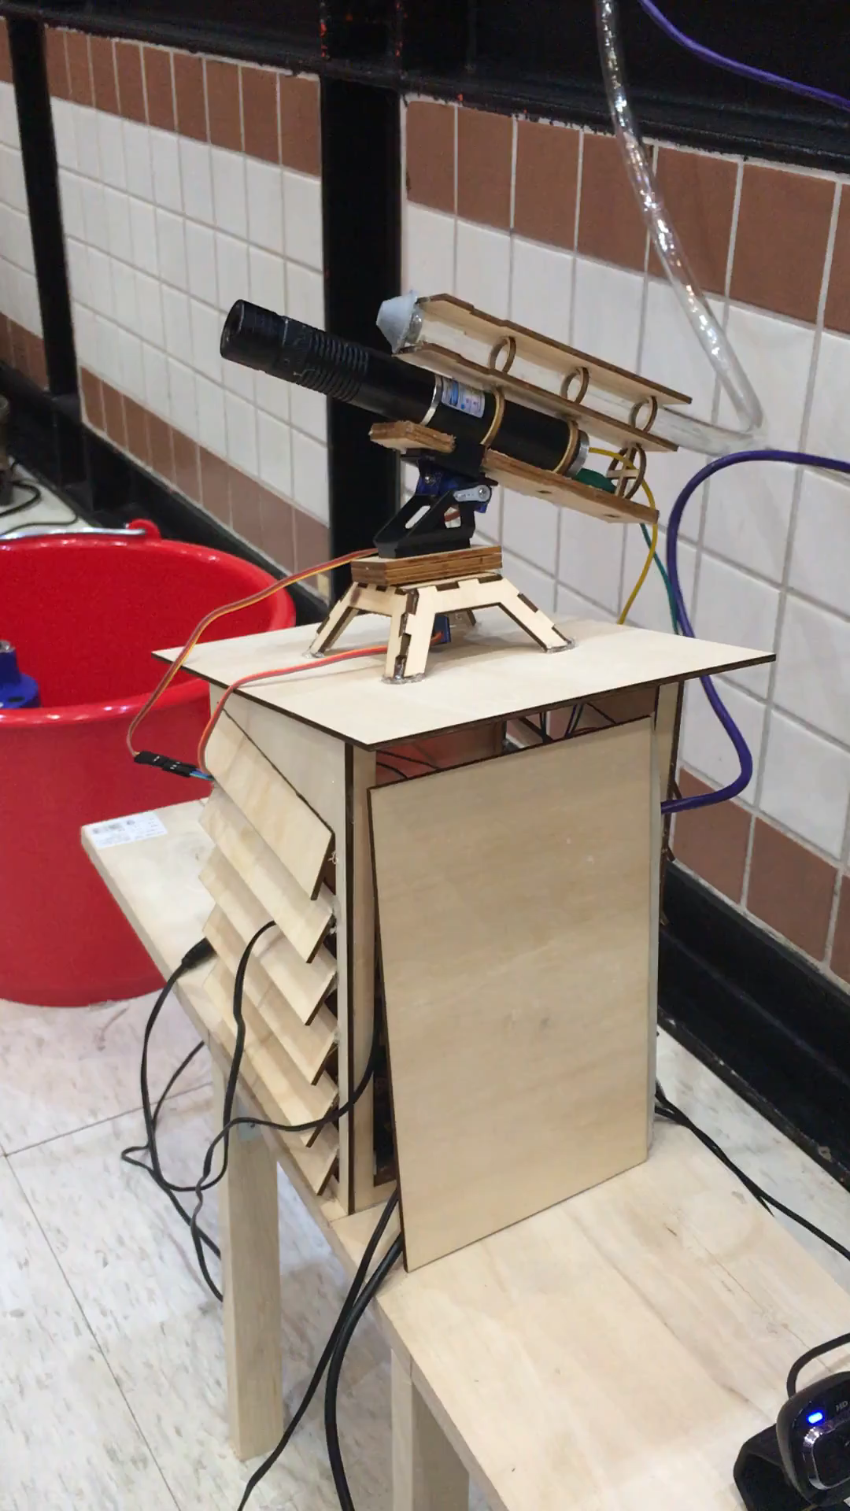

Slide 8
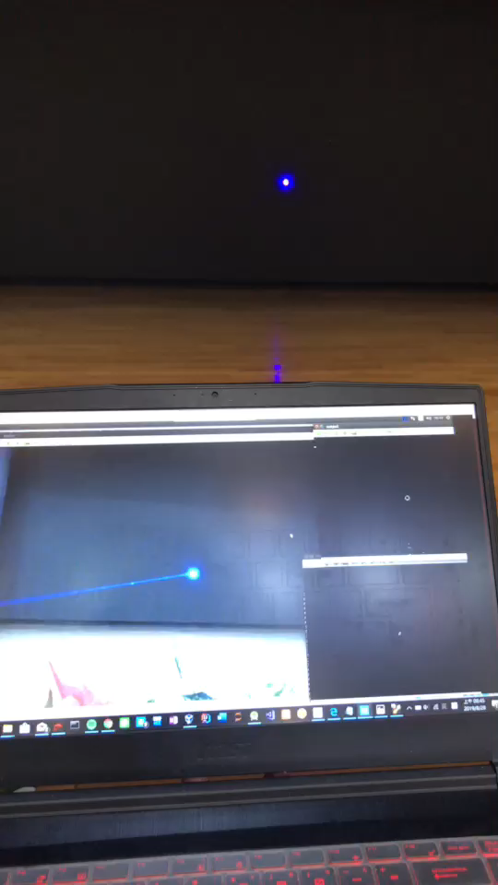
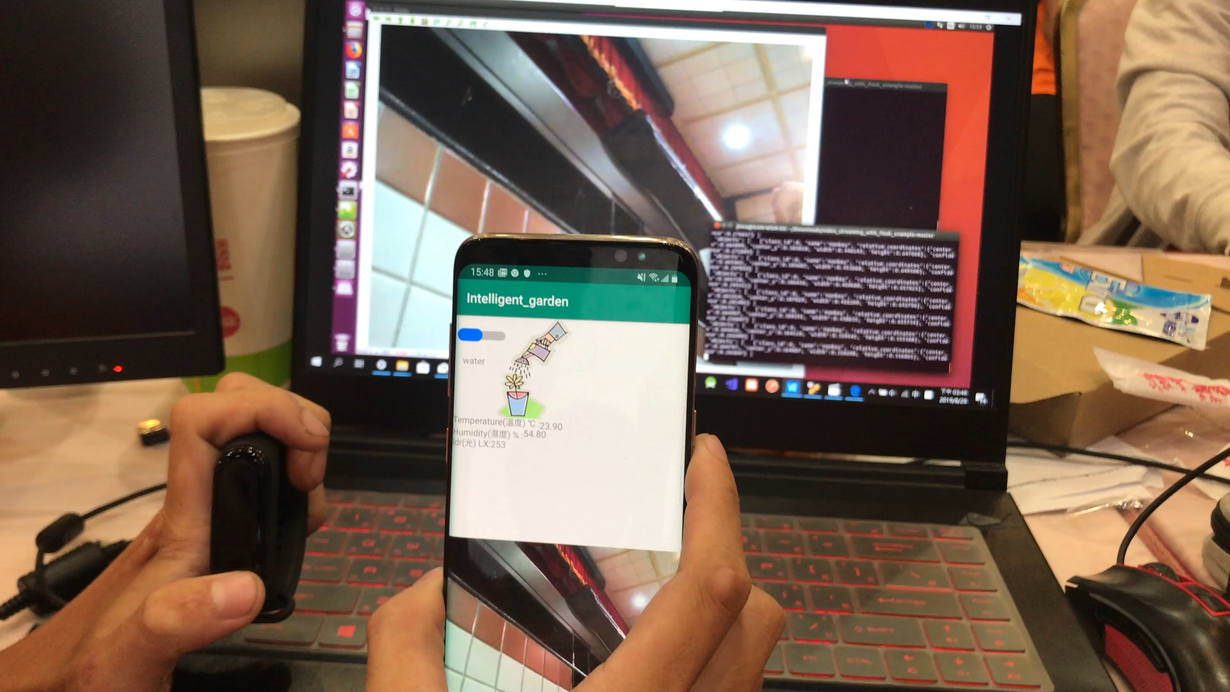

Slide 9
Question had been asked
Q: Is it going to hurt monkey?
A: Yes, so right now we abandoned this solution.
I am trying to use ultrasonic to do the same job.

Slide 10
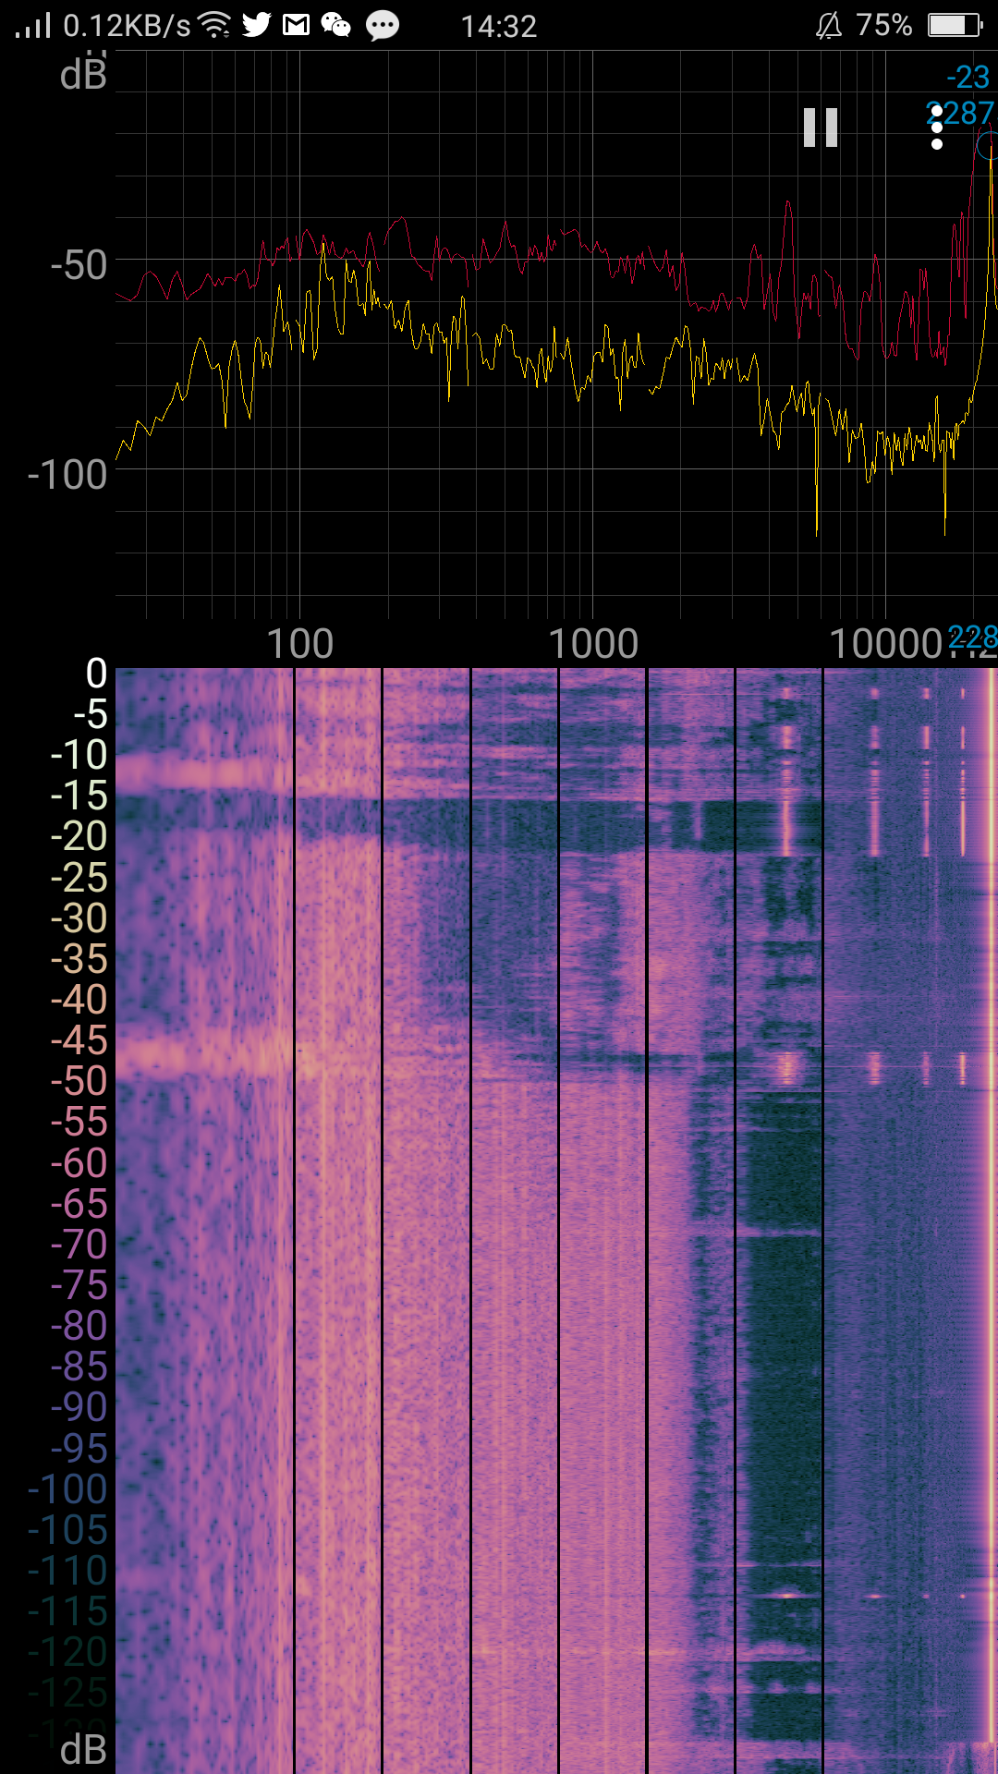
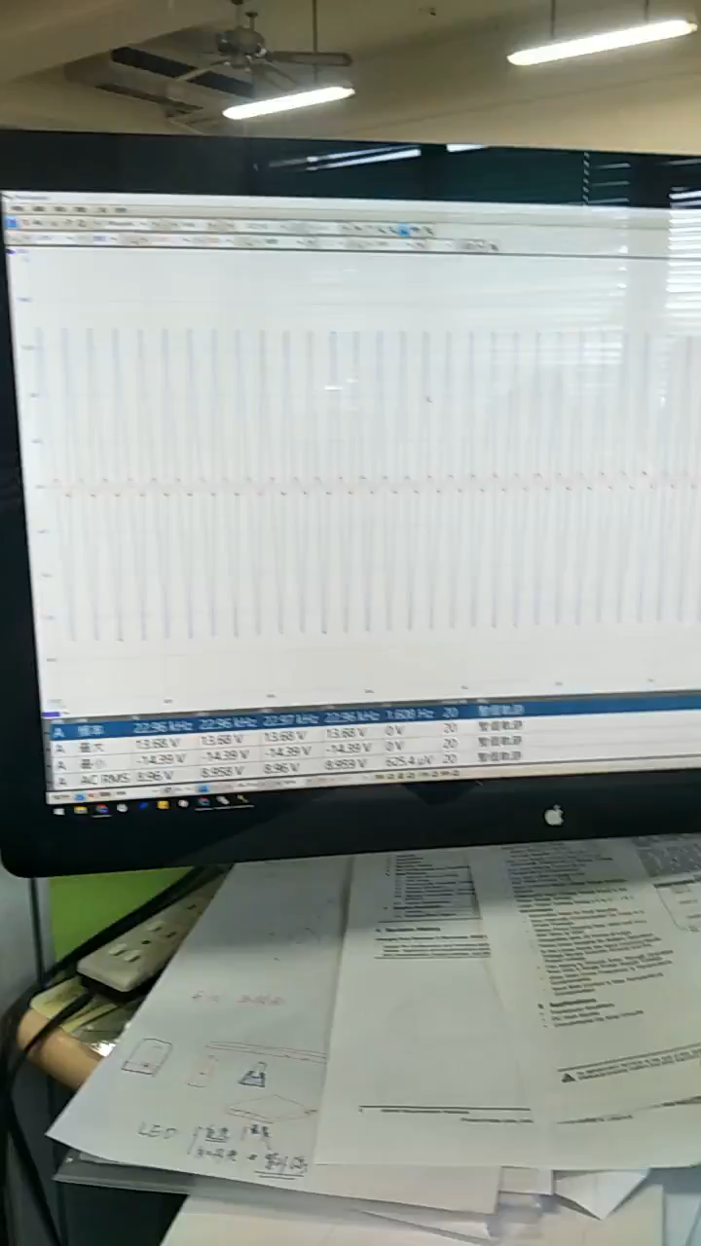

Slide 11
End.
Thank You!!!

